Slide 1
Long Island City Community Conversation
Office of District Planning, CEC 30
May 20, 2026

Slide 2
Introductions
Office of District Planning
  Rhea Cumberbatch – Associate Director of Queens Planning
  Julianne Cianciaruso – Director of Queens Planning
  Kristina Chan – Associate Director of Analytics
  Jonathan Geis – Senior Director of Analytics
District 30 Superintendent’s Team
  Superintendent Lisa Hidalgo
CEC 30
  Whitney Toussaint – CEC 30 Co-President
  Victoria Medelius – CEC 30 Co-President

Slide 3
Goals and Norms for Tonight’s Presentation
Review current and projected enrollment data for existing and new schools in Long Island City serving grades K-5;
Provide more information on school zones and an overview of the rezoning process; and
Answer questions and collect feedback on a potential rezoning in Long Island City.
Notes:
CEC 30 to share meeting norms

Slide 4
Agenda
Next Steps and Contact Information
Discussion and Feedback
Elementary School Seat Need and Planning for New Buildings
School Zones and Rezoning Overview

Slide 5
Elementary School Seat Need And Planning For New Buildings

Slide 6
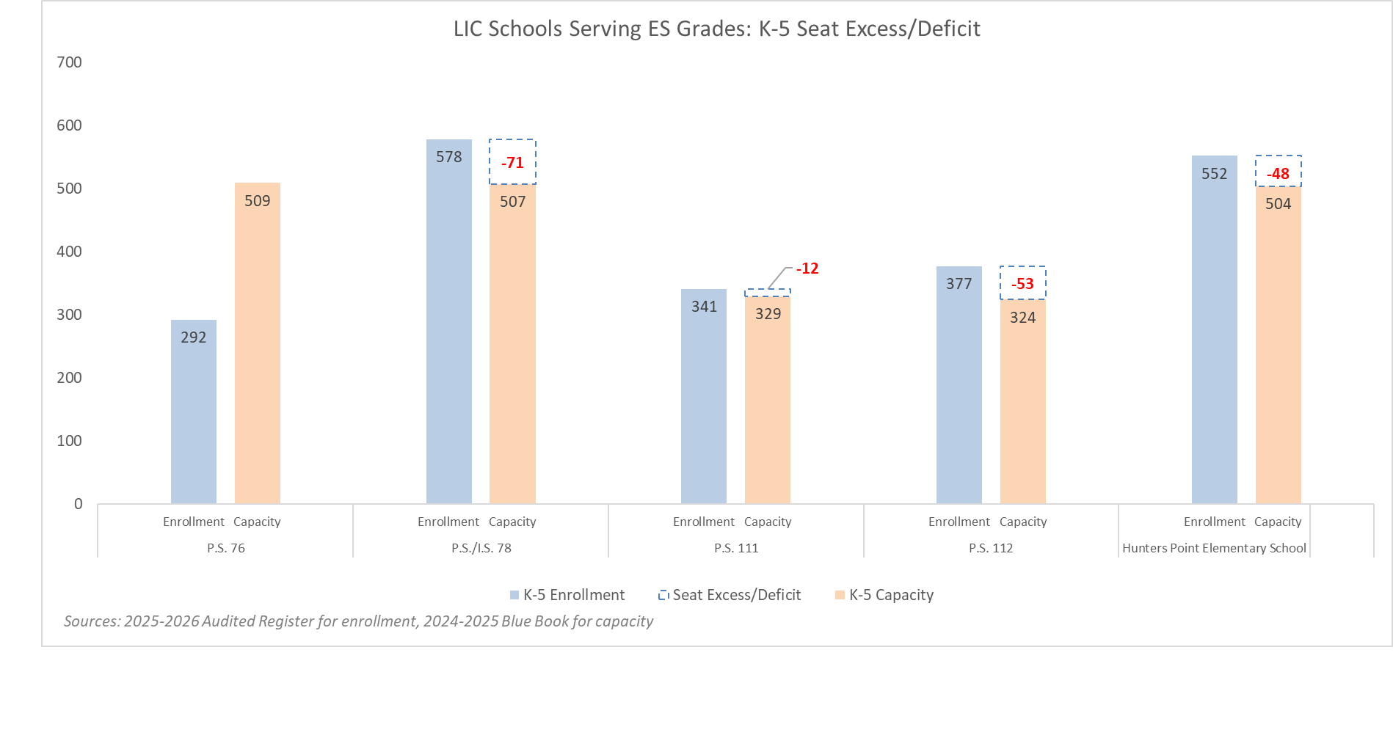
LIC Schools Serving Grades K-5: Seat Need
The majority of schools in LIC serving grades K-5 have a deficit of K-5 seats. There is a need for additional seats to meet demand.
Notes:
Presenter: KC
Total K-5 enrollment across Long Island City (LIC) schools serving grades K-5 grew by 40% between 2020-21 and 2025-26.

Slide 7
District 30 New School Buildings
There are two new school buildings planned to open in the upcoming school years to address seat need and overcrowding.
Building | Address | Anticipated Opening | Planned Use
Parcel C Q341 | 1-50 54th Avenue | September 2027 | A proposal was approved to expand P.S. 384 from a K-5 school to a K-8 school and to re-site P.S. 384’s grades K-3 and pre-K to Parcel C in the 2027-2028 school year, where it will be co-located with District 75.
Court Square Q508 | 23-10 43rd Avenue | September 2028 | Open a new school with Kindergarten (P.S. 439Q, 30Q439) in the 2026-2027 school year in an unoccupied Pre-K Center (Q346: 11-11 40th Ave) and propose to re-site it to Court Square, where it would be co-located with District 75 in the 2028-2029 school year.

Slide 8
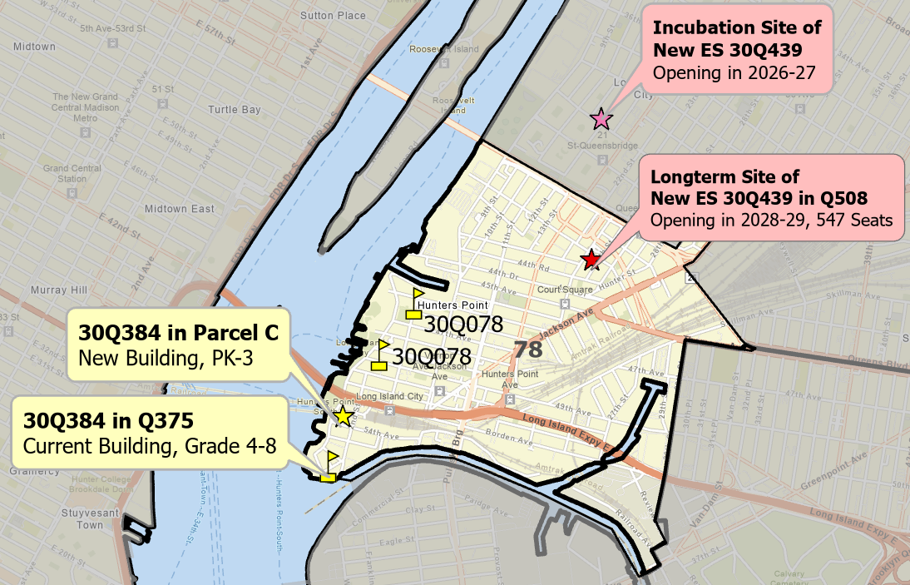
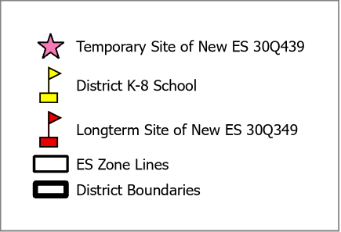
Plans for New School Buildings
These plans allow us to add both elementary and middle school seats in LIC, in response to community feedback.
  Future plans to open P.S. 439Q in Q508 is pending NYCPS issuing a proposal that would be voted on by the Panel for Educational Policy.

Slide 9
School Zones and Rezoning Overview

Slide 10
What is a School Zone?
A zone is a specific geographic area.
  Zoned schools give priority to students residing in a specific geographic area, known as the zone, to attend.
Most zones have one zoned school. A few zones, called shared zones, have multiple zoned schools.
  Students living in a zone with one zoned school have priority to attend that one school.
  Students living in a zone with multiple zoned schools, or a shared zone, have priority to attend any of the zoned schools within the zone. However, students will only receive an offer to one school, and priority will be given to applicants based on sibling priority and other criteria.
    Families can list all, some, or none of their zoned schools on their application.
    How families rank zoned schools on their application is taken into consideration when making offers.
    However, even if a family receives an offer to one of their zoned schools, they can still be on the waitlist for another zoned school they ranked higher on their application.
Notes:
Elyse Santiago from OSE to cover this slide

Slide 11
What is a School Rezoning?
Rezoning is a collaborative process where the geographic areas of school zones are changed and/or new zones are created, as governed by Chancellor’s Regulation A-185.
Rezonings are an important lever for improving educational access and learning conditions and increasing diversity and integration.
  Improve educational access
    Create a zone for a new school option
    Increase access to high quality schools
    Increase diversity in or across zones
    Allow families to make informed decisions regarding their children’s educational experience
  Improve learning conditions
    Alleviate overcrowding
    Reduce waitlists and capping
    Equalize or balance utilization across buildings
    Remove Transportable Classroom Units (TCUs)

Slide 12
Developing Proposed Zone Lines
Factors we take into consideration:
  New residential construction
  Geographic barriers
  Travel distance
We draw zone lines in a way that:
  Contains appropriate number of residents for a school’s size, based on recent public school enrollment trends
  Promotes diversity and integration across schools
Steps:
  Determine the target zone size for each school
  Project future residents
  Draw new zone line scenarios

Slide 13
Potential Rezoning Landscape in LIC
P.S./I.S. 78’s building is not large enough to accommodate all the students living in its zone, and P.S. 384 has typically bridged the gap by serving additional students living in the P.S./I.S. 78 zone.
With new school P.S. 439Q opening, there is an opportunity to consider rezoning in this area, targeting the most overcrowded areas.
The earliest a potential rezoning could go into effect is next year’s admission cycle for the 2027-2028 school year.
All plans around potential rezoning and timeline will be made in collaboration with the community, and no decisions have been made.
Notes:
We are working in close partnership with SCA to identify opportunities to address the space needs of all schools in order to support class size compliance.
As we develop rezoning scenarios, we will explore how this new capacity can support increased compliance in this area.

Slide 14
Rezoning Impacts
Which students would be impacted by a rezoning?
  Proposed changes would primarily impact incoming pre-K, kindergarten, or new students to the system in the 2027-2028 school year. There is no impact to current students.
Will students retain their sibling priority if a rezoning occurs?
  When applying to a school impacted by an elementary school rezoning, children entering pre-kindergarten or kindergarten who live where a zone is changing can retain their zoned sibling priority if they have a sibling attending that school.
How do we determine which students are eligible for bussing?
  K-2 students are eligible for yellow bussing or OMNY card if they live further than 0.5 miles from their school site.
Notes:
Presenter: EG
Emphasize bolded language

Slide 15
What is the Rezoning Process?
(1) Need Identified
(2) Community Engagement
(4) Proposal Presentations
(5) CEC Votes
The need to rezone can be raised by NYCPS, the CEC, schools, or the broader community.
(3) Data Analysis and Scenarios
Community conversations continue throughout the rezoning process.
NYCPS analyzes enrollment trends, demographics, school capacity,
student residential and housing stock data.
A proposal for zone line changes is presented publicly to the CEC by ODP and the Superintendent.
There are opportunities for public feedback and Q&A.
Conversations with the CEC, school principals and communities, elected officials, and other stakeholders.
Feedback informs new zone lines.
CEC votes within 45 days after a proposal is submitted.
Fall 2025
Winter-Spring 2026
Summer-Fall 2026
Fall 2026
Winter-Spring 2026

Slide 16
Discussion & Feedback

Slide 17
Statements from District 30 Superintendent Hidalgo &
CEC 30 Co-Presidents
Whitney Toussaint & Victoria Medelius

Slide 18
Guiding Questions
Are there any questions or ideas about the rezoning process?
  What methods of engagement do you think work best for the LIC community?
To what extent is it a priority that all students currently zoned for P.S./I.S. 78 remain zoned for either P.S./I.S. 78, P.S. 384, or P.S. 439Q?
Would LIC families prefer to have one shared zone for P.S./I.S. 78 and P.S. 384 or separate zones for P.S./I.S. 78 and P.S. 384?
Are there any geographic barriers in the LIC area that we should keep in mind?
  Is the Queensboro Bridge a geographic barrier for families?
Notes:
Two minutes

Slide 19
Next Steps and
Contact Information

Slide 20
Next Steps
Today is a continued opportunity to discuss the rezoning process, timeline, and methodology.
We will convene additional community conversations and provide further opportunities for feedback, including but not limited to a presentation at CEC 30’s upcoming calendar meeting on June 8th at 6:30pm.
Should we pursue a rezoning, ODP will use this feedback to develop new proposed zone lines to present to CEC 30 and the broader community.
Rezoning proposals are typically submitted and voted on by late Fall to allow for implementation in the subsequent admissions process.

Slide 21
Office of District Planning
Contact Information
Rhea Cumberbatch, Associate Director of Queens Planning
rcumberbatch2@schools.nyc.gov
Julianne Cianciaruso, Director of Queens Planning
jcianciaruso@schools.nyc.gov
Kristina Chan, Associate Director of Analytics
kchan31@schools.nyc.gov

Slide 22
Appendix

Slide 23
Rezoning Process Frequently Asked Questions
What data does ODP base its analysis on?
  Historical student residential data, enrollment patterns, school demand, residential construction data, demographics, and each school’s building capacity, most of which is publicly accessible.
How can the public provide input as part of this potential process and decision?
  NYCPS values community feedback and works closely with a variety of stakeholders throughout the rezoning process to ensure proposals are responsive to feedback. Community members can provide feedback on a rezoning proposal by attending a public meeting, submitting written comments to ODP or by calling the CEC.
What would the timeline be for a potential rezoning here?
  Pending a proposal by NYCPS and subsequent CEC approval by the fall of the 2026-2027 school year, proposed changes would take effect in the admissions process for the 2027-2028 academic year.

